Slide 1
NSX visual identity toolkit
Spring 2017

Slide 2


NSX Visual Identity
Approach
To provide a distinct look and feel for the NSX brand within the guidelines of the VMware corporate brand, through iconography, illustration, color and visuals. The NSX brand is versatile and can communicate at multiple technical levels the features and benefits it provides to VMware and it’s customers.
Color
Type
Visuals
Application
Icon Library
Templates

Slide 3
NSX Visual Identity
Approach
Color
Type
Visuals
Pantone Cool Gray 9C
R 119
G 119
B 122
C 55
M 47
Y 44
B 10
#717074
Pantone 7470
C 80
M 15
Y 0
K 45
R 0
G 105
B 144
#006990
Pantone 7461
C 78
M 28
Y 0
K 0
R 0
G 149
B 211
#0095d3
Pantone 7458
C4 0
M 0
Y 5
K 6
R 137
G 203
B 223
#89cbdf
Pantone 654
C 100
M 67
Y 0
K 38
R 0
G 61
B 121
#003d79
Application
Icon Library
Templates
Pantone 390
C 22
M 0
Y 100
K 8
R 194
G 205
B 35
#c2cd23
Pantone 369
C 59
M 0
Y 100
K 7
R 109
G 179
B 63
#6db33f
Pantone 364
C 65
M 0
Y 100
K 42
R 56
G 124
B 44
#387c2c
Pantone 144
C 0
M 48
Y 100
K 0
R 248
G 152
B 29
#f8981d
Pantone 180
C 0
M 79
Y 100
K 11
R 217
G 84
B 30
#d9541e

Slide 4
NSX Visual Identity
Approach
Color
Type
Visuals
Arial Regular
Arial Bold
Application
Icon Library
Templates
ABCDEFGHIJKLM
NOPQRSTUVWXYZ
abcdefghijklm
nopqrstuvwxyz
1234567890
ABCDEFGHIJKLM
NOPQRSTUVWXYZ
abcdefghijklm
nopqrstuvwxyz
1234567890

Slide 5
NSX Visual Identity
Approach
Features & benefits:
These illustrations are generally used for high level concepts and/or ideas that utilize the illustration style of the new visual assets.
The illustrations utilize more than one color to show depth and detail
Color
Type
Visuals
Features & benefits
Technical diagrams
Photography
Application
Icon Library
Templates
APP
OS

Slide 6
NSX Visual Identity
Approach
Technical Diagrams
A technical diagram is a visual that communicates a complex set of details. It is important that the icon style is used to help tell the story with minimal detail.
The icons are very minimal with limited detail and color
Color
Type
Visuals
Features & benefits
Technical diagrams
Photography
Application
Icon Library
Templates

Slide 7

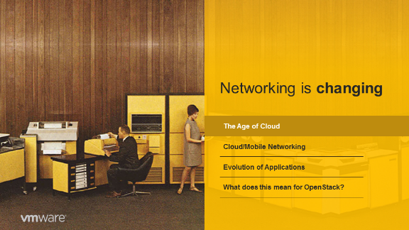

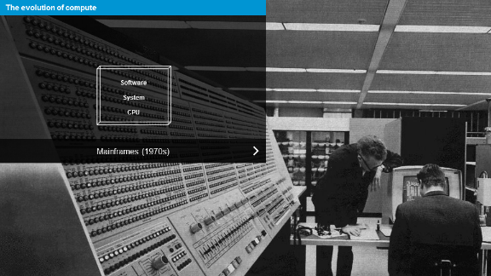
NSX Visual Identity
Approach
Photography
The use of photography within the NSX Visual Identity is authentic, purposeful and aspirational. Below are examples of photography used within a presentation to help transition from one idea to the next or to simply make a visual statement.
Color
Type
Visuals
Features & benefits
Technical diagrams
Photography
Application
Icon Library
Templates

Slide 8

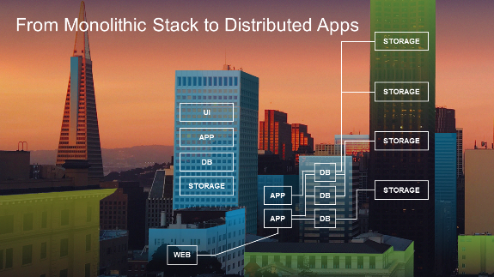
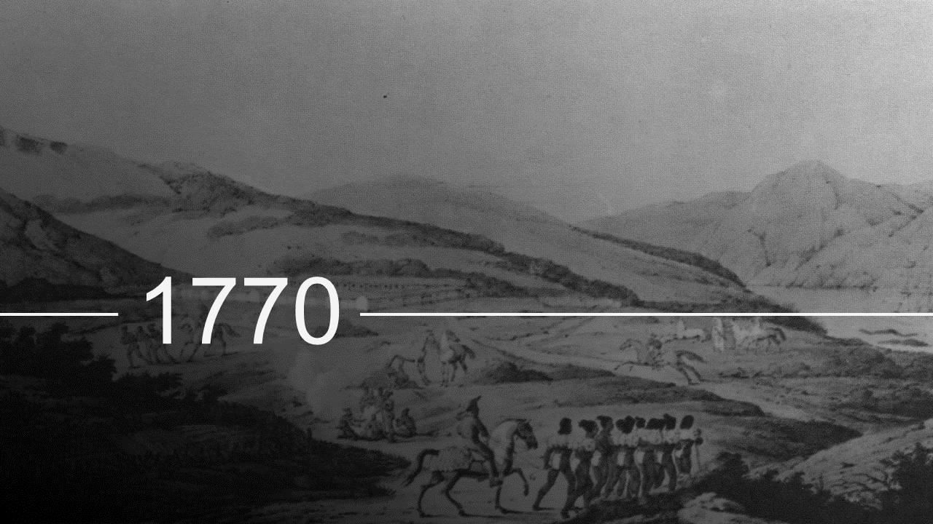
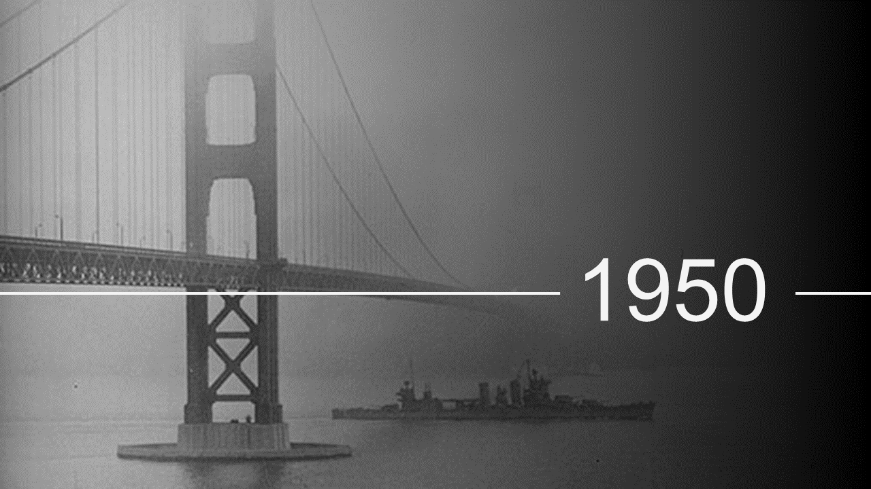


NSX Visual Identity
Approach
Color
Type
Visuals
Features & benefits
Technical diagrams
Photography
Application
Icon Library
Templates

Slide 9
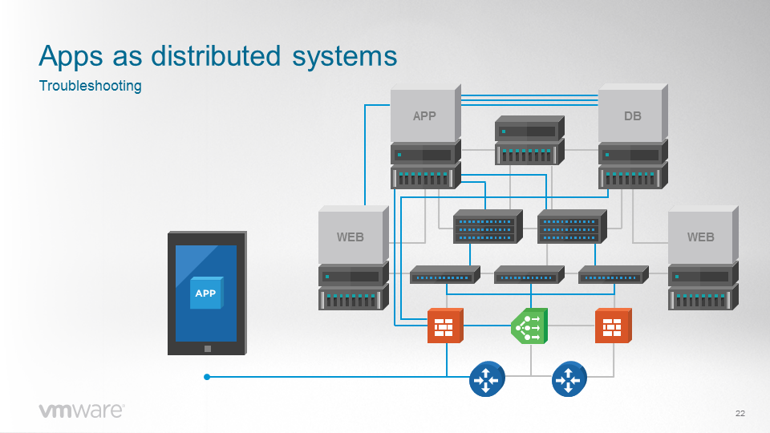
NSX Visual Identity
Approach
Color
Type
Visuals
Application
Features & benefits
Technical diagrams
Icon Library
Templates

Slide 10
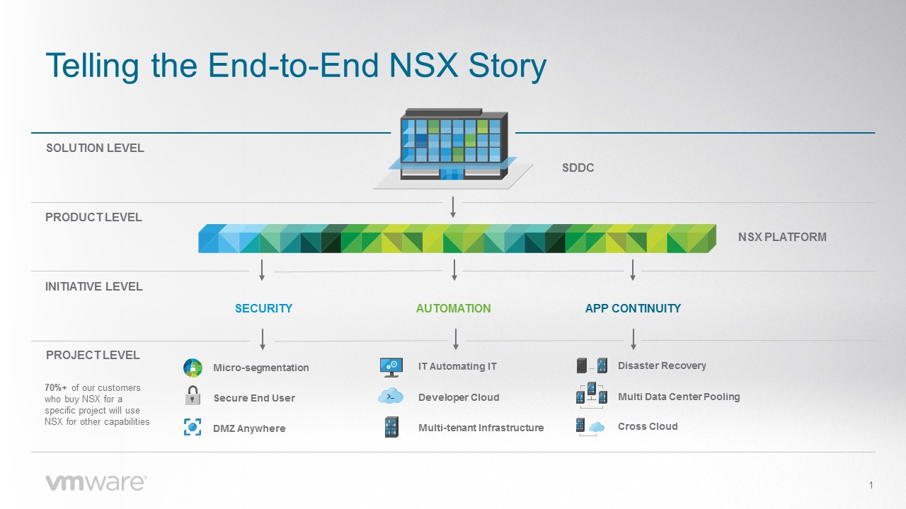
NSX Visual Identity
Approach
Color
Type
Visuals
Application
Features & benefits
Technical diagrams
Icon Library
Templates

Slide 11
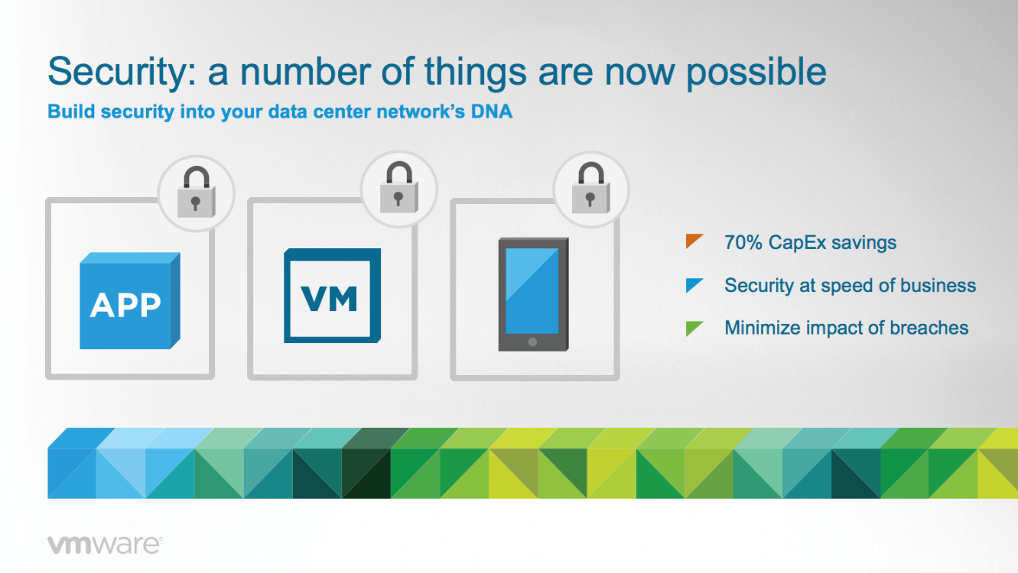
NSX Visual Identity
Approach
Color
Type
Visuals
Application
Features & benefits
Technical diagrams
Icon Library
Templates

Slide 12
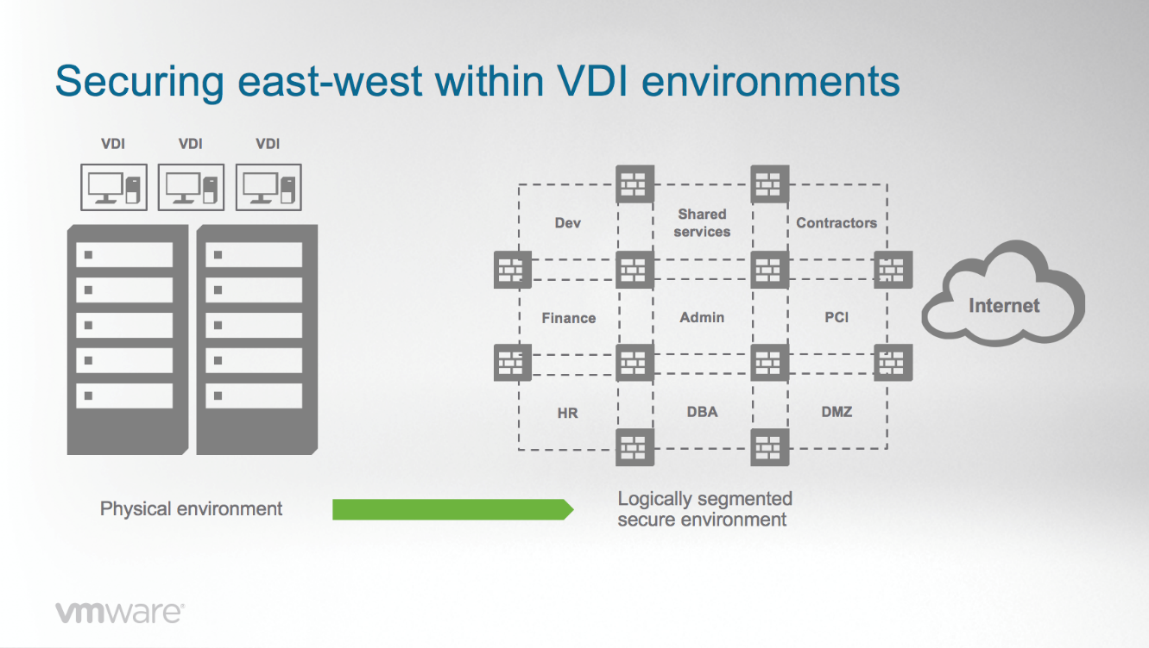
NSX Visual Identity
Approach
Color
Type
Visuals
Application
Features & benefits
Technical diagrams
Icon Library
Templates

Slide 13
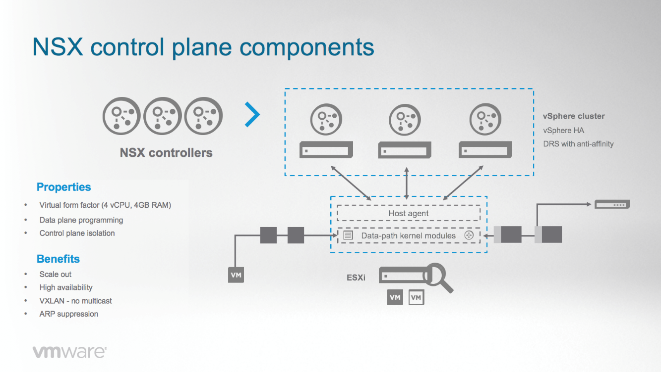
NSX Visual Identity
Approach
Color
Type
Visuals
Application
Features & benefits
Technical diagrams
Icon Library
Templates

Slide 14
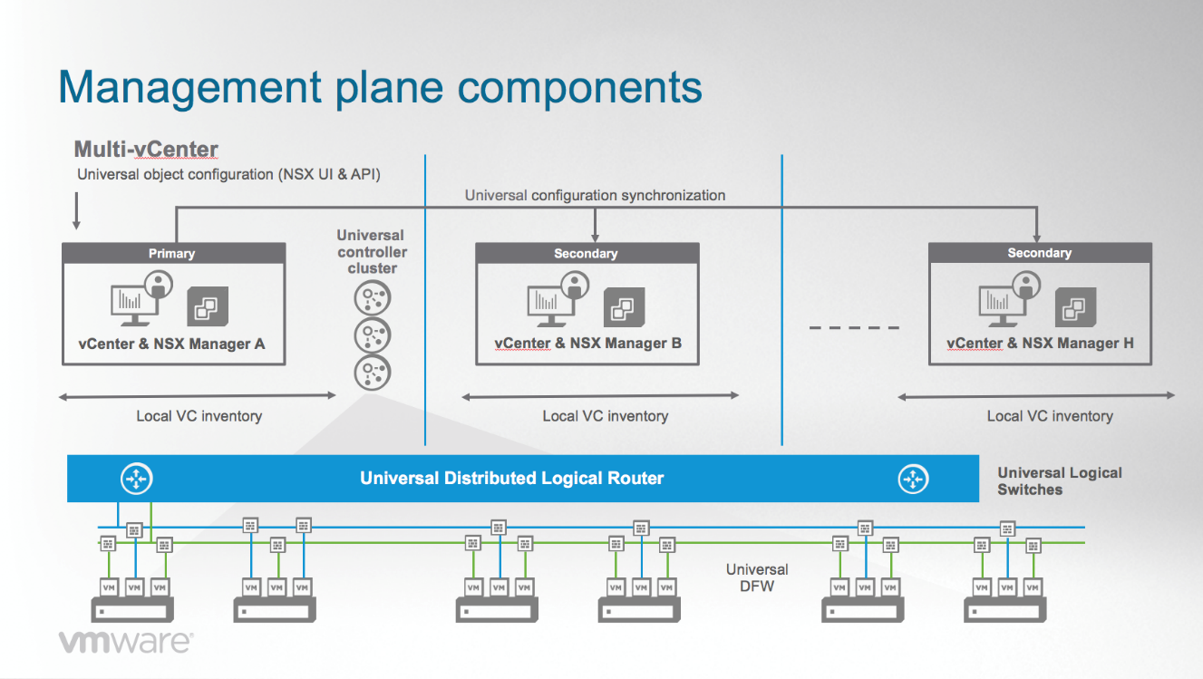
NSX Visual Identity
Approach
Color
Type
Visuals
Application
Features & benefits
Technical diagrams
Icon Library
Templates

Slide 15
Features & benefits icons
NSX Visual Identity
Approach
Toolkit:
The following slides are a collection of various features & benefits and technical diagram icons for your use. Please reference the visuals tab (slides 5-6) on when and how to use this icon set.
Color
Type
Visuals
Application
Icon Library
Templates
Technical icons

Slide 16
Desktop
Thin client
Laptop
Laptop 2
Laptop with password
Laptop with password 2
Tablet
Tablet with password
iPhone apps
iPhone password
iPhone - white
iPhone - black
…
…
NSX + AIRWATCH – Option 1
NSX + AIRWATCH – Option 2

Slide 17
Data center 1
Data center 2
Data center 3
Server stack
Server stack (2)
Server stack (3)
Rack server
Rack servers (3)
Top of rack
Top of rack (3)
Modular switch
Switch
Database

Slide 18
NSX manager
Dashboard
NSX Cloud Service Manager
NSX plane node
IT automating IT
Virtual desktop
User 1
User 2
User 3
Hacker
Group
Badge
User 1 dark
User 2 dark
User 3 dark
Heart

Slide 19
IT automating IT
Developer cloud
Multi-tenant infrastructure
Micro-segmentation
DMZ anywhere
Secure end user
Virtualization/mobility
Multi data center pooling
Disaster recovery
Cross cloud
Full automation
Consistent policy
Cloud
Cloud scale
Dev/Test/Prod – Option 1
Dev/Test/Prod – Option 2

Slide 20
Firewall
Load balancer
Controller
Composer
Switch
Router
Physical firewall
Physical load balancer
Physical controller
Physical composer
Physical switch
Physical router
Firewall with NSX
Load balancer with NSX
Controller with NSX
Composer with NSX
Switch with NSX
Router with NSX

Slide 21
VPN
Gateway NSX Edge
Cluster
VPN
Data
NSX plane node
NSX Badge
App (trans)
App
VM
VM 2
Micro-segmentation
Alert
Secure
Secure 2
DMZ anywhere
Encryption
Compliance

Slide 22
Increase
Magnify
IOT
Virtualization
App, data, OS
VM (detailed)
THIN APP
THIN APP
APP
OS
DATA
OS
OS
Disconnect
Connected
Document
Virtualization (editable)
App, data, OS (editable)
VM (detailed) editable
vSphere
Process
Inventory
Throughput, scale
Tag

Slide 23
NSX Service Insertion
NSX Service Insertion
NSX Security Insertion
NSX Security Insertion
NSX Visibility Insertion
NSX Visibility Insertion
Virtual router
Virtual firewall
Virtual load balancer
Virtual switch
Benchmark
Network 1
Network 2
Container 1
Container 2
Container 3

Slide 24
Policy - 1
Policy - 2
Policy - 3
Policy - 4
Policy - 5
Policy - 6
IT Automating IT
Developer Cloud
Multi-tenant Infrastructure
Micro-Segmentation
DMZ Anywhere
Secure End User
Disaster Recovery
Multi Data Center Pooling
Cross Cloud

Slide 25
NSX Cloud Service Manager
Private cloud
Public cloud
Cross-cloud
NSX Public Cloud Gateway
Identity-Based Firewall

Slide 26
Distributed logical router, firewall, and switch:
This layer can be scaled within PowerPoint while still retaining its shape. To adjust the length of the distributed layer, ungroup and drag the box to shorten or lengthen as needed. Reposition the router, firewall, or switch icons at the front and end of the box as needed. Be sure not to distort or stretch the icons themselves.
Distributed logical router
Distributed logical router
Distributed firewall
Distributed firewall
Distributed switch
Distributed switch

Slide 27
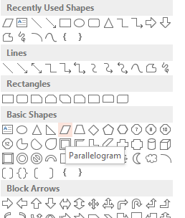
…
…
…
…
…
…
…
…
…
…
APP
APP
…
OS
OS
…
Hypervisor layer:
This layer can be scaled within PowerPoint while still retaining it’s 45° angles. As a hypervisor layer, it’s recommended that a 20% opacity is applied to show details that may be sitting below the hypervisor.
Drop shadows:
The same shape (Parallelogram, within Basic Shapes) used for the hypervisor can be used as a drop shadow for hardware and anything that needs to appear suspended or floating (airy). Can scale as needed while retaining the 45° angles.

Slide 28
Features & benefits icons
NSX Visual Identity
Approach
Toolkit:
The following slides are a collection of various features & benefits and technical diagram icons for your use. Please reference the visuals tab (slides 5-6) on when and how to use this icon set.
Color
Type
Visuals
Application
Icon Library
Templates
Technical icons

Slide 29
Desktop
Thin client
Laptop
Laptop with password
Tablet
Tablet with password
Cell phone
Cell phone with password
Cell phone with apps
Virtual machine
Data center 1
Data center 2
Data center 3

Slide 30
Rack server
Rack server stack
Dashboard
NSX manager
Server stack
Switch
Cloud management
NSX plane node 2
IT automating IT
Cloud 2
Database 2
Cross cloud
Cloud
Top of rack
Modular switch

Slide 31
Firewall
Load balancer
Controller
Composer
Switch
Router
Physical firewall
Physical load balancer
Physical controller
Physical composer
Physical switch
Physical router
Firewall with NSX
Load balancer with NSX
Controller with NSX
Composer with NSX
Switch with NSX
Router with NSX

Slide 32
Gateway NSX Edge
Network II
VPN
Data
NSX plane node
NSX Badge
L2 Switch
App
VM
VM 2
Micro-segmentation
Alert
Secure
Secure 2
DMZ anywhere
Encryption

Slide 33
User
Virtualization/mobility
Cluster
Hacker
Group
Benchmark
Badge
Multi data center pooling
Disaster recovery
Network
Full automation
Consistent policy
NSX Service Insertion
NSX Security Insertion
NSX Visibility Insertion

Slide 34
Increase
Magnify
IOT
Virtualization
App, data, OS
VM (detailed)
THIN APP
THIN APP
APP
OS
DATA
OS
OS
Disconnect
Connected
Document
Virtualization (editable)
App, data, OS (editable)
VM (detailed) editable
vSphere
Process
Inventory
Throughput, scale
Developer cloud
Tag

Slide 35
NSX Visual Identity
Approach
Toolkit:
The following slides are a collection of various template slides you can copy and paste into your PowerPoint presentations to create a consistent visual style.
Copy and paste using the “keep formatting” command to import the master slides into your document.
Title slide
Agenda slide
Basic slide with headline
Basic slide with headline and subheadline
Section divider slide
Quote slide
Thank you / closing slide
Color
Type
Visuals
Application
Icon Library
Templates

Slide 36
NSX PowerPoint Template
Subtitle

Slide 37
Agenda
1 | First topic
2 | Second topic
3 | Third topic
4 | Fourth topic
5 | Fifth topic

Slide 38
Basic slide

Slide 39
Basic slide with subhead
Subhead

Slide 40
Transition slide

Slide 41

Insert photo as background
“Quote slide option 1.”
Quote First and Last Name
Company and/or title

Slide 42
“Quote slide option 2.”
Name, Company / Role

Slide 43
Thank You!
Subtitle

